Slide 1
Flutter – Event Handling

Slide 2
Flutter Gestures
Gestures are primarily a way for a user to interact with a mobile (or any touch based device) application.
Gestures are generally defined as any physical action / movement of a user in the intention of activating a specific control of the mobile device.
Tap: Touching the surface of the device with fingertip for a short period and then releasing the fingertip.
Double Tap: Tapping twice in a short time.
Drag: Touching the surface of the device with fingertip and then moving the fingertip in a steady manner and then finally releasing the fingertip.
Flick: Similar to dragging, but doing it in a speeder way.
Pinch: Pinching the surface of the device using two fingers.
Spread/Zoom: Opposite of pinching.
Panning: Touching the surface of the device with fingertip and moving it in any direction without releasing the fingertip

Slide 3
Gesture Detector
Flutter provides an excellent support for all type of gestures through its exclusive widget, GestureDetector.
GestureDetector is a non-visual widget primarily used for detecting the user’s gesture.
A very broad class with many different gestures registered.
Some of the gestures and the corresponding events are given in notes:
Notes:
Tap
onTapDown
onTapUp
onTap
onTapCancel
Double tap
onDoubleTap
Long press
onLongPress
Vertical drag
onVerticalDragStart
onVerticalDragUpdate
onVerticalDragEnd
Horizontal drag
onHorizontalDragStart
onHorizontalDragUpdate
onHorizontalDragEnd
Pan
onPanStart
onPanUpdate
onPanEnd

Slide 4
Inkwell
A rectangular area of a Material that responds to touch.
Same as GestureDetector, but it shows ripple effect which is not provided by GestureDetector.
onTap
onPress
etc

Slide 5
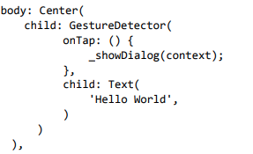
Sample Code
_showDialog is method, just being called inside onTap

Slide 6
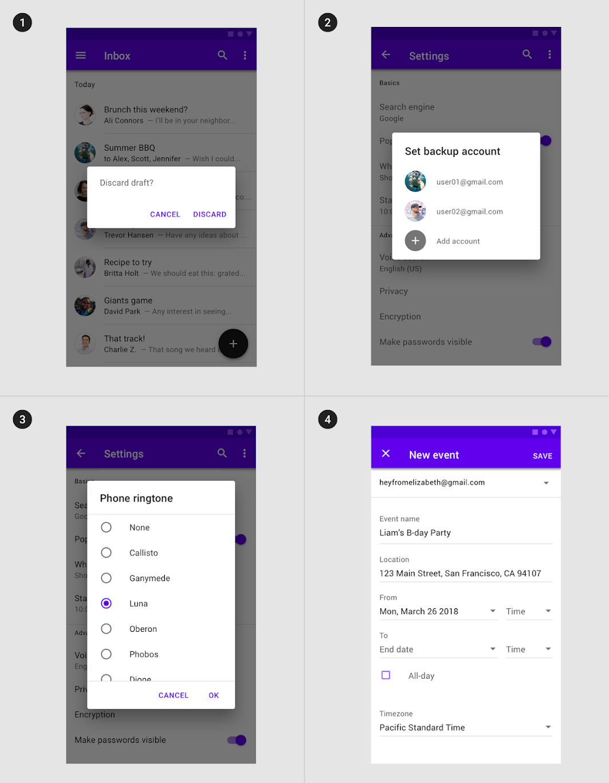
Dialogs
A dialog is a type of modal window that appears in front of app content to provide critical information or ask for a decision. Dialogs disable all app functionality when they appear, and remain on screen until confirmed, dismissed, or a required action has been taken.
There are four types of dialogs:
1. Alert,
2. Simple,
3. Confirmation,
4. Full-screen

Slide 7
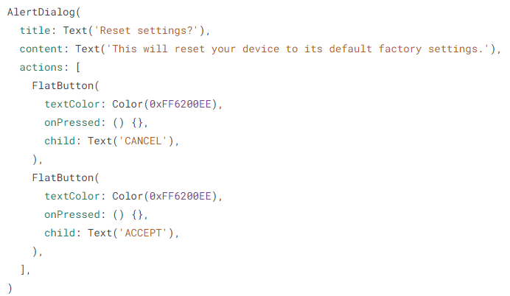
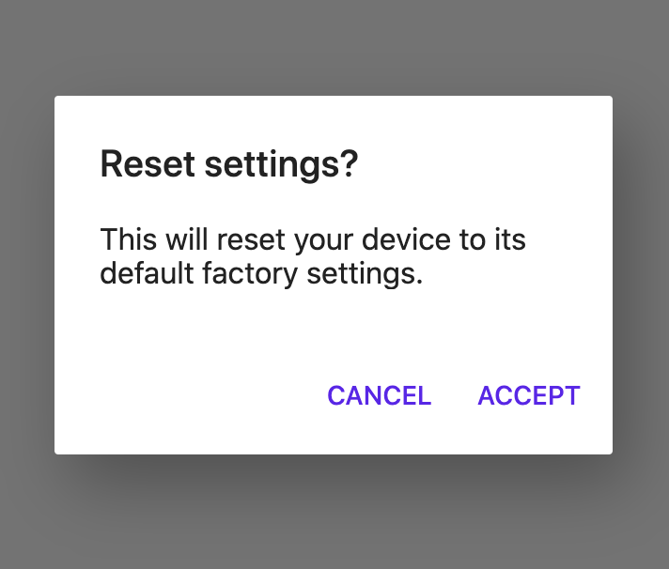
Alert dialog
Alert dialogs interrupt users with urgent information, details, or actions.

Slide 8
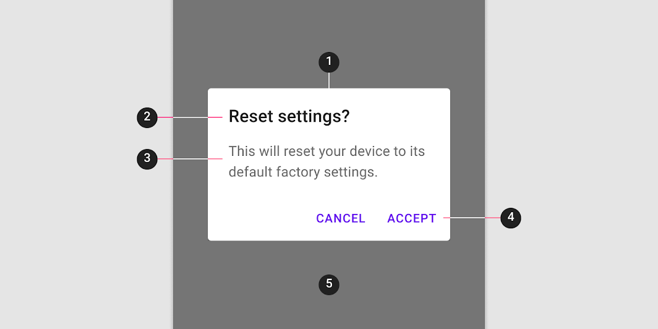
Alert dialog anatomy and key properties
Container
Title (optional)
Supporting text
Buttons
Scrim
Notes:
Container attributes
PropertiesColor : backgroundColor
Shape : shape
Elevation : elevation
Title attributes
PropertiesText label : title
Color : style on title when using a Text
Typography : style on title when using a Text
Supporting text attributes
PropertiesText label : content
Color : style on content when using a Text
Typography : style on content when using a Text
Buttons attributes
PropertiesButtons : actions

Slide 9
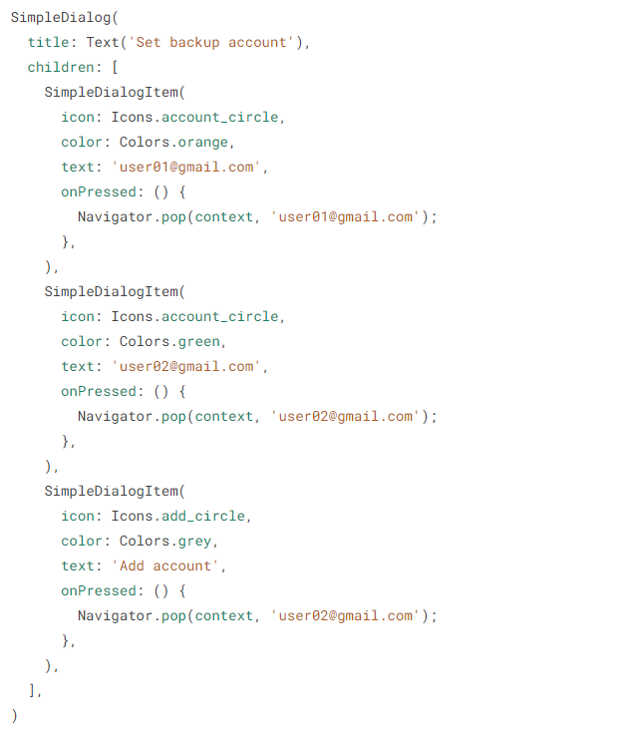
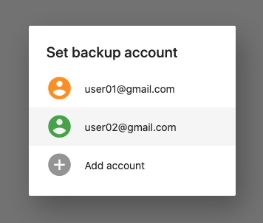
Simple dialog
Simple dialogs can display items that are immediately actionable when selected. They don’t have text buttons

Slide 10
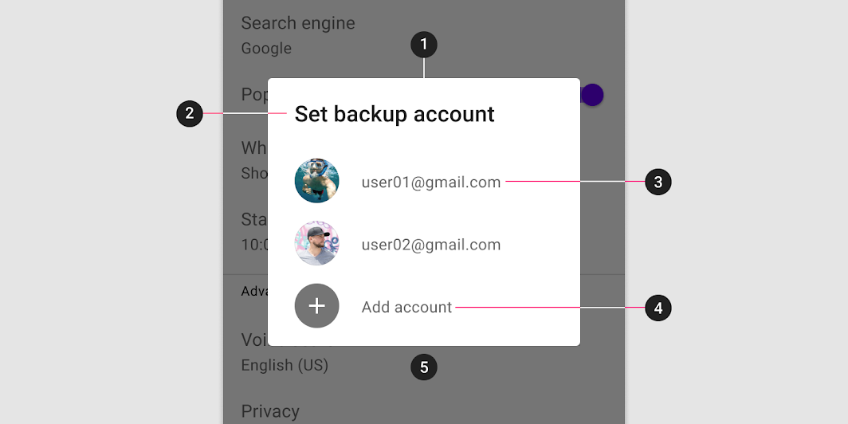
Simple dialog anatomy and key properties
Container
Title
List item
Supporting visual
Primary text
Button
Scrim
Notes:
Container attributes
PropertiesColor : backgroundColor
Shape : shape
Elevation : elevation
Title attributes
PropertiesText label : title
Color : style on title when using a Text
Typography : style on title when using a Text
List item supporting visual attributes
PropertiesOptions : children (Use SimpleDialogOption and customize its child parameter as needed.)

Slide 11
Confirmation dialog
Confirmation dialogs give users the ability to provide final confirmation of a choice before committing to it, so they have a chance to change their minds if necessary.
If the user confirms a choice, it’s carried out. Otherwise, the user can dismiss the dialog. For example, users can listen to multiple ringtones but only make a final selection upon tapping “OK.”

Slide 12
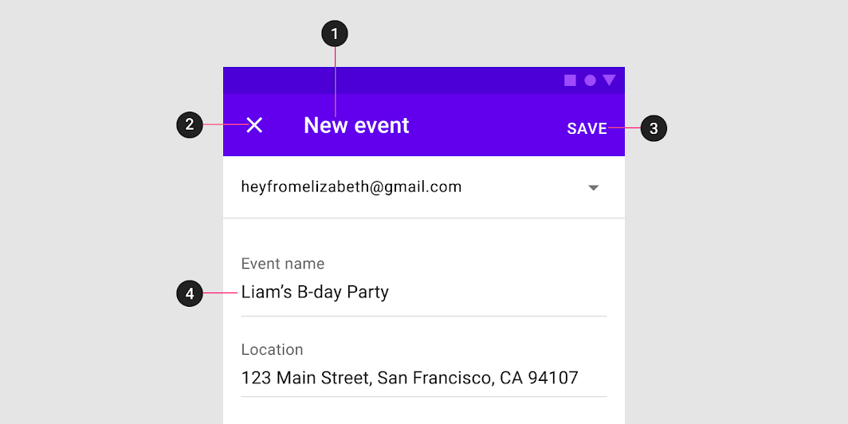
Full-screen dialog
To use a full-screen dialog, simply set the fullscreenDialog to true when pushing a new MaterialPageRoute
Full-screen dialog anatomy
Title
Icon Button
Buttons
Scrim

Slide 13
Flutter – State Management

Slide 14
Flutter – State Management
Managing state in an application is one of the most important and necessary process in the
Let us consider a simple shopping cart application.
User will login using their credentials into the application.
Once user is logged in, the application should persist the logged in user detail in all the screen.
Again, when the user selects a product and saved into a cart, the cart information should persist between the pages until the user checked out the cart.
User and their cart information at any instance is called the state of the application at that instance. life cycle of an application.

Slide 15
Flutter – State Management
A state management can be divided into two categories based on the duration the particular state lasts in an application.
Ephemeral − Last for a few seconds like the current state of an animation or a single page like current rating of a product. Flutter supports its through StatefulWidget.
app state − Last for entire application like logged in user details, cart information, etc., Flutter supports its through scoped_mode

Slide 16
Navigation and Routing
In any application, navigating from one page / screen to another defines the work flow of the application.
MaterialPageRoute is a widget used to render its UI by replacing the entire screen with a platform specific animation
Syntax
Navigator.push is used to navigate to new screen using MaterialPageRoute widget

Slide 17



Ephemeral State Management
Since Flutter application is composed of widgets, the state management is also done by widgets
The entry point of the state management is Statefulwidget.
Create a state for RatingBox, _RatingBoxState by inheriting State
Override the createState of StatefulWidget method to create the state, _RatingBoxState

Slide 18
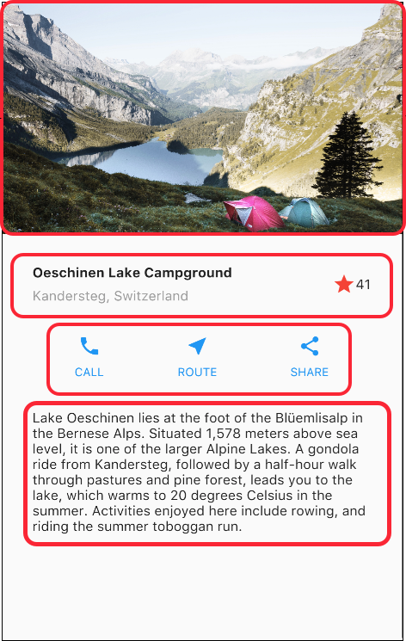
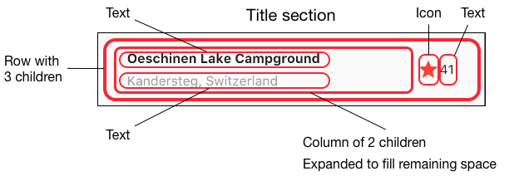
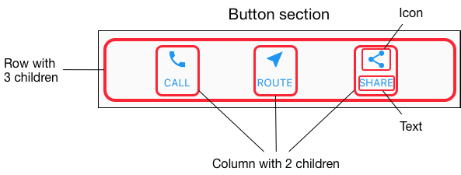
Lab Task

